Slide 2
Agile Software Development with Microsoft Visual Studio ALM
DEV-B212
Aaron Bjork
Peter Provost

Slide 3
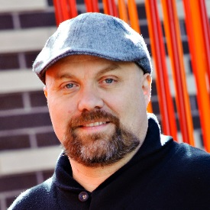
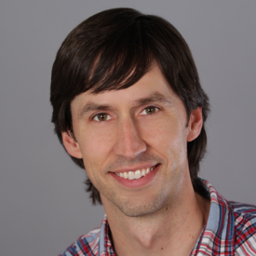
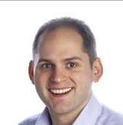
DEV-B321
Improving Developer Productivity and Software Quality with Microsoft Visual Studio Application Lifecycle Tools
DEV-B323
Deep Dive into the Team Foundation Server Agile Planning Tools
DEV-B330
Flexible Source Control with Team Foundation Service and Git

Slide 4
What is this talk?
Fine tuning your process, environment and culture
Playing the same game across all of your teams
Dealing with various kinds of debt
Measuring the outcome you want, not the one you don’t
The makings of a great product owner
The Visual Studio agile transformation

Slide 5


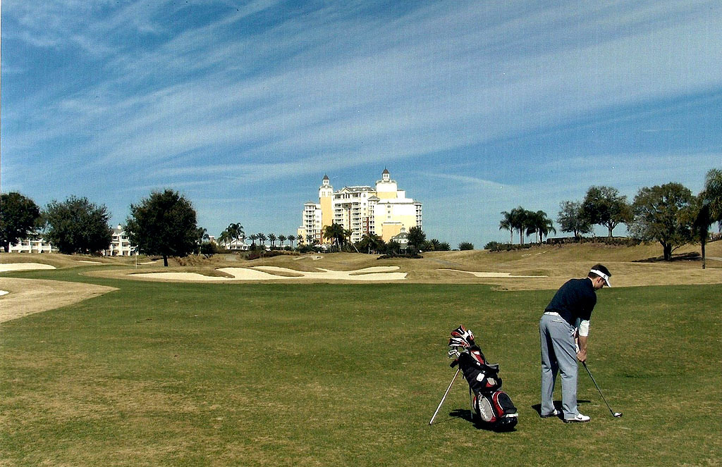

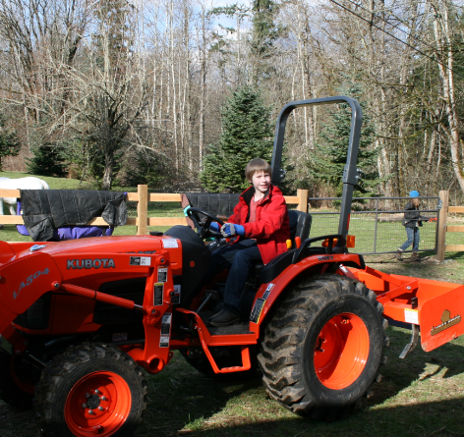
Who is Aaron?
Seattle native
Married (16 years)
3 kids
2 dogs (whippets)
Golfer (12 handicap)
Bought buying a tractor
Jeans, not khakis
Agile
Business major
Microsoft 11 years
Program Manager
Business school
3 kids
2 dogs
2 horses
1 cat
? goats
Seattle native

Slide 6

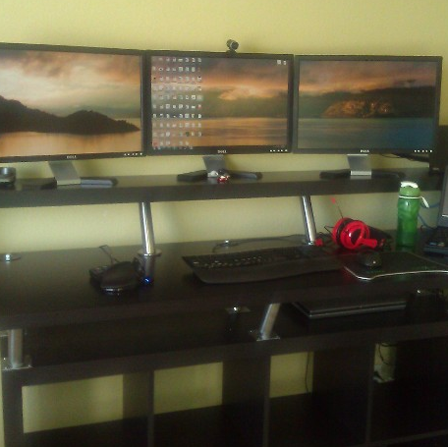
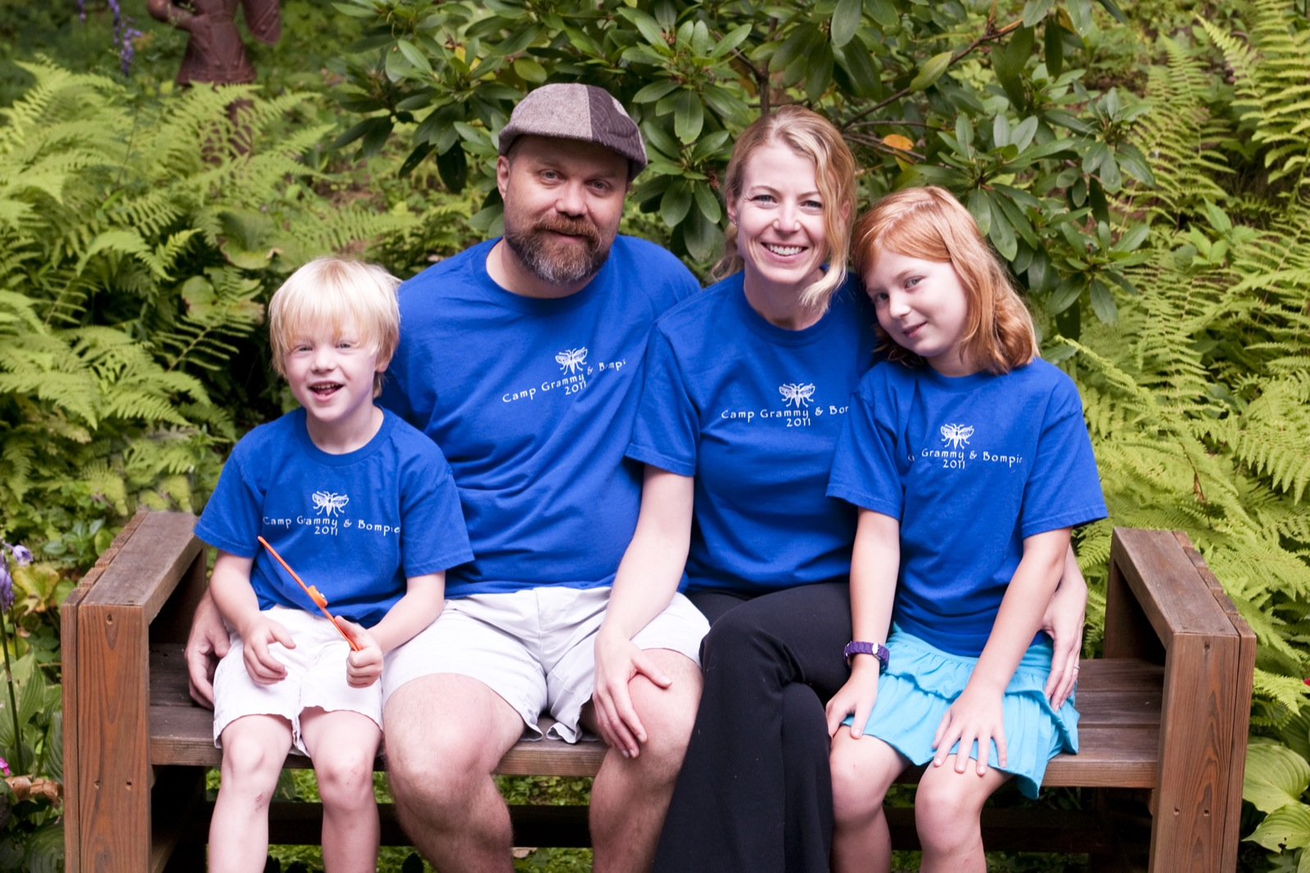
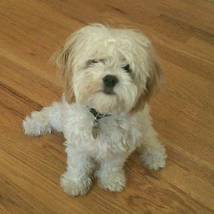
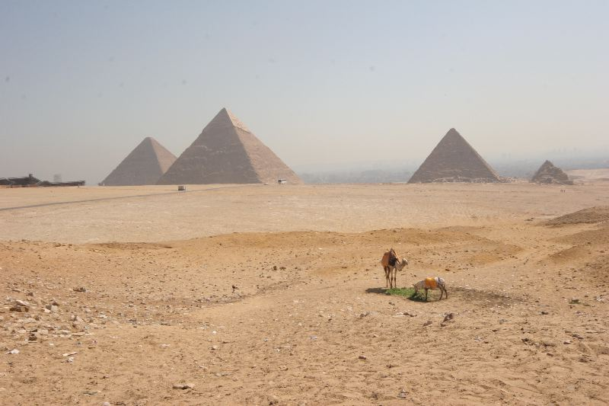

Who is Peter?
Work for VS but live in Denver
Involved in the agile >10 years
Grew up all over the world
15 foot daily commute
Married for 12 years
2 kids & 1 dog
Play bass in a rock cover band
Study Kenpō Karate with my son
Uniform is jeans, shorts & t-shirts

Slide 7
A
B

Slide 8
What’s Changed?
TFS 2008
10 – 12 weeks
TFS 2010
6 weeks
TFS 2012
3 weeks
Jan
Feb
Mar
Apr

Slide 9
Control
Environment

Slide 10
Control
Environment

Slide 11
Do you care about control? Or your team’s environment?

Slide 12
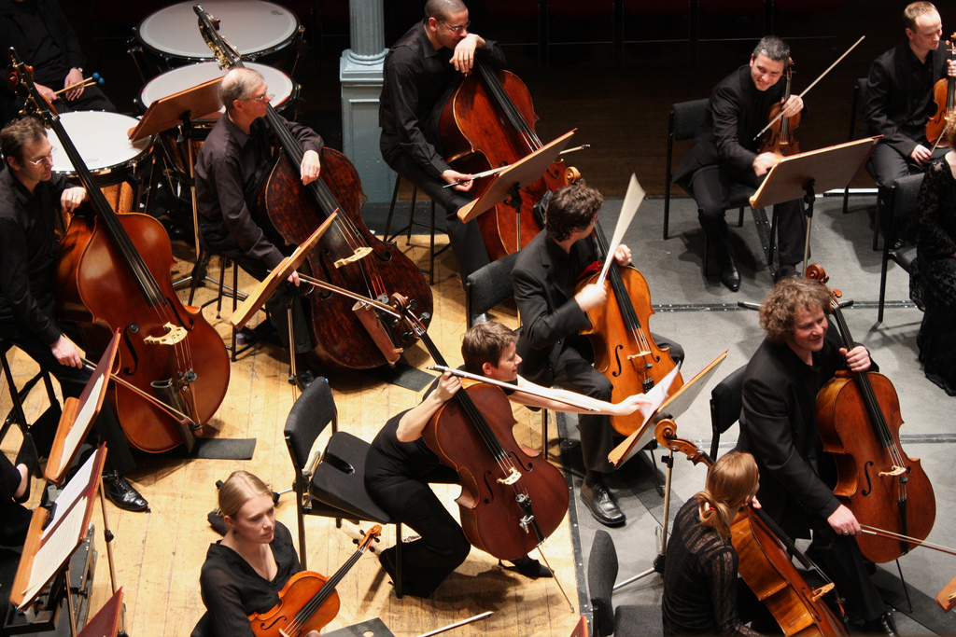
Retrospectives
At regular intervals, the team reflects on how to become more effective, then tunes and adjusts its behavior accordingly.
Tune and adjust
The teams behavior

Slide 13
Retrospectives
TFS 2008
10 – 12 weeks
TFS 2010
6 weeks
TFS 2012
3 weeks
Jan
Feb
Mar
Apr

Slide 14
Retrospectives
At regular intervals, the team reflects on how to become more effective, then tunes and adjusts its behavior accordingly.
Tune and adjust
The teams behavior

Slide 15
Retrospectives
At regular intervals, the team reflects on how to become more effective, then tunes and adjusts its behavior accordingly.
Tune and adjust
The teams behavior

Slide 16
Retrospectives
At regular intervals, the team reflects on how to become more effective, then tunes and adjusts its behavior accordingly.
Tune and adjust
The teams behavior

Slide 17
Retrospectives
At regular intervals, the team reflects on how to become more effective, then tunes and adjusts its behavior accordingly.
Tune and adjust
The teams behavior

Slide 18
Is your team regularly adjusting its behavior?

Slide 19
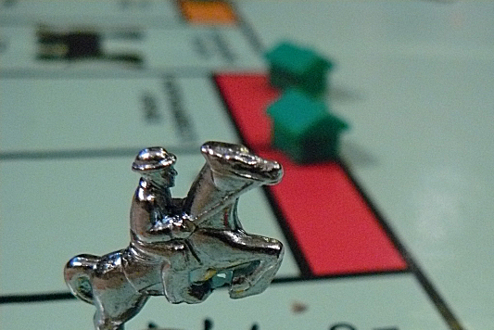
Play the same game
What is the object?
What are the rules?
How do you keep score?
Rules
Score

Slide 20
Iteration Length
VS
TFS
VSTS
VS
TFS
VS
VSTS
TFS
VSTS
VS
TFS
VSTS
2008
2010
2012
2013

Slide 21
Area Paths – Where is the work?
2008
2010
2012
2013
Relative count of root area paths used in Visual Studio releases

Slide 22
Are your teams playing the same game you are?

Slide 23

Debt
Bugs
Technical debt
Never ending backlogs
Non-functional req’mnts
Process
Bugs
Interest

Slide 24
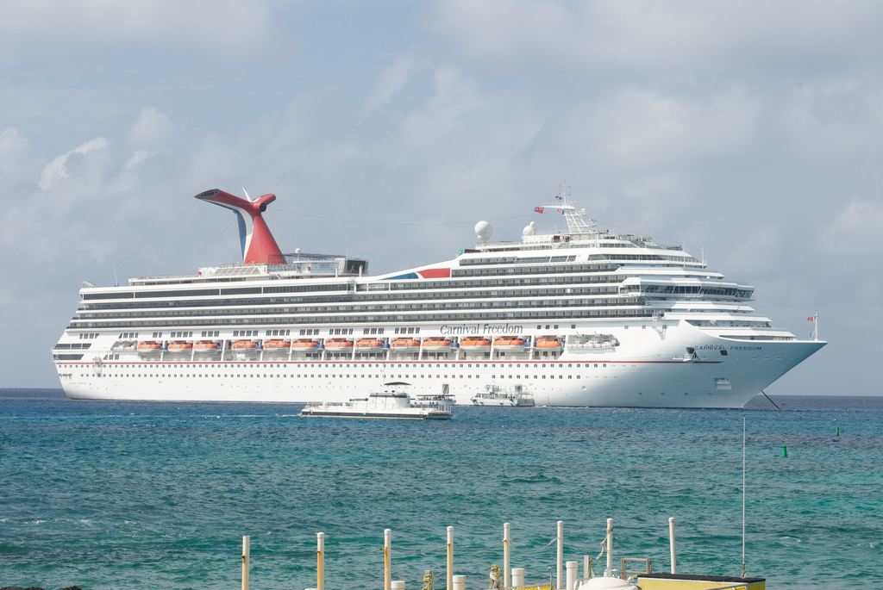
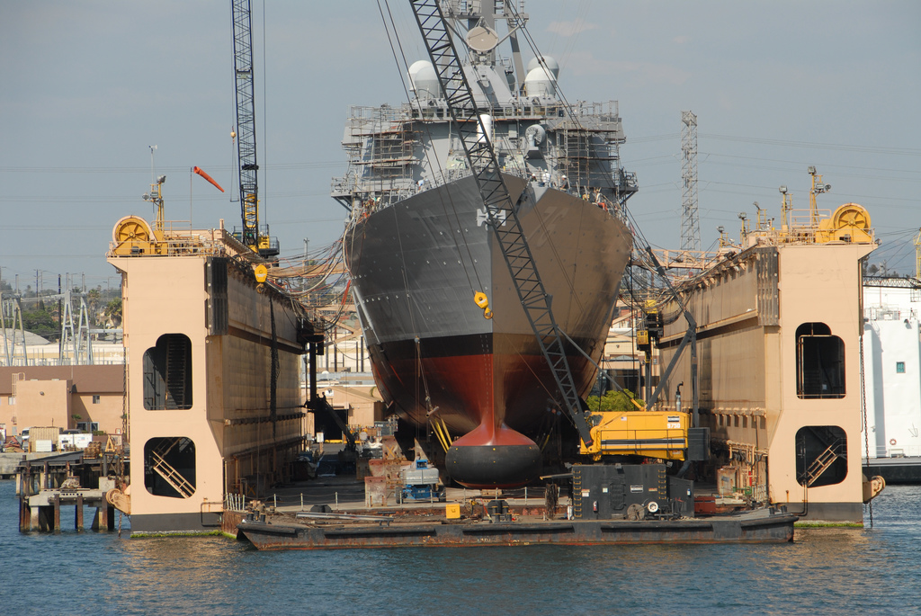
Debt Leads to…

Slide 25
How much debt are your teams carrying?

Slide 26

You Get What You Measure
Measurement affects outcomes
Tools enable new ways to measure, but should you?
Outcomes
Tools

Slide 27
Planning for debt
Doh!
Yay, we’re done!
Construction
Stabilize
1 year
1 year

Slide 28
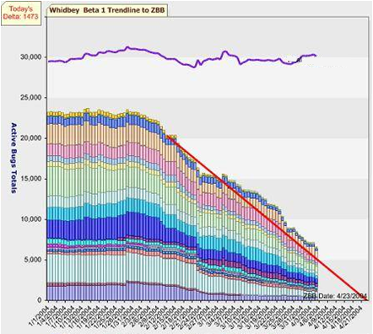
A bug creation machine?
When management tracks features using bugs as the primary measure…
You get piles of code, and piles of bugs.

Slide 29
What are you measuring? What does that produce? What should you be measuring?

Slide 30
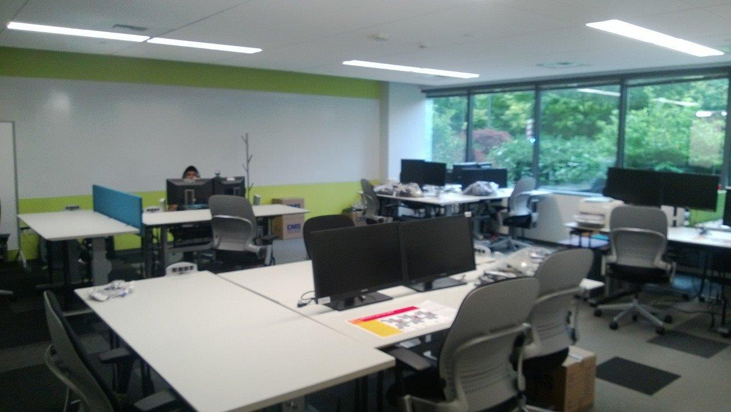
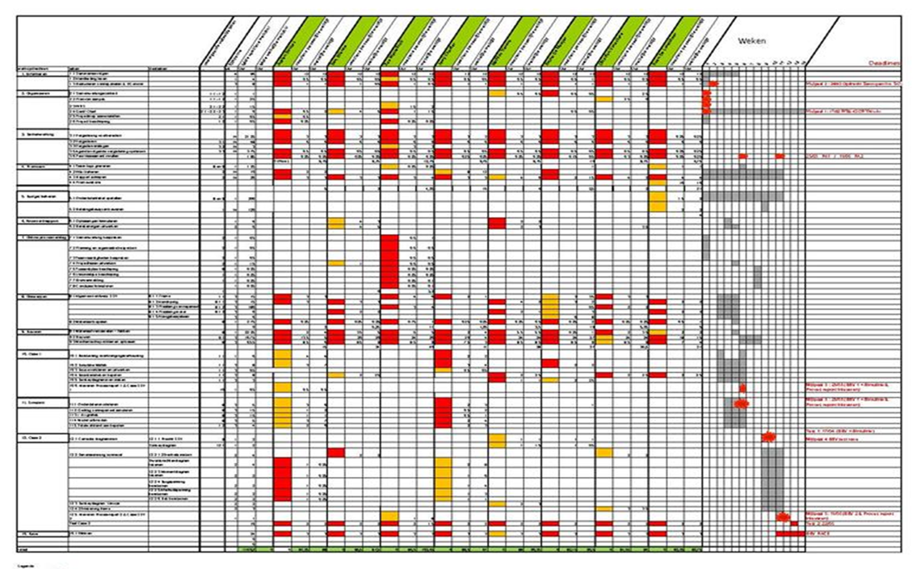
PM or PO?
PM cares about schedule
PO cares about the product
PM oversees the team
PO is a part of the team
Schedule?
Value!

Slide 31
Does your PO sit in the room? Or outside the room?

Slide 32
Summary
Fine tune your process, environment and culture
Play the same game across all of your teams
Deal with your debt
Measure the outcome you want
Be a great product owner
Environment

Slide 33
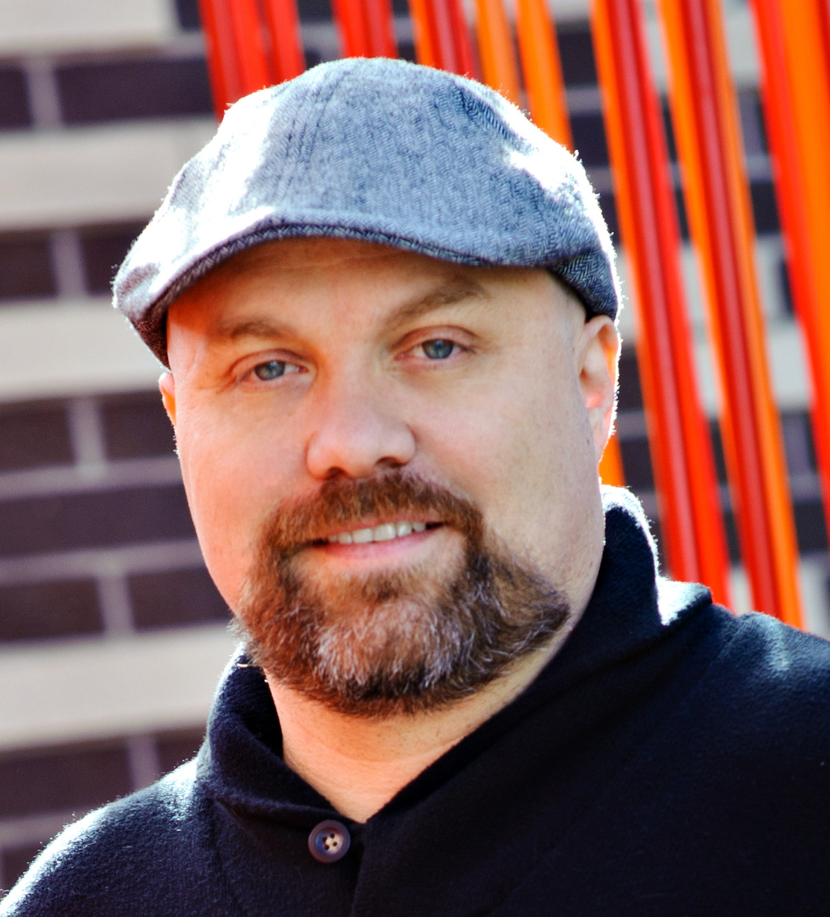
Thanks!
Aaron Bjork
Program Manager Lead
aaron.bjork@microsoft.com
@aaronbjork
Peter Provost
Program Manager Lead
Peter.Provost@microsoft.com
@pprovost
www.peterprovost.org

Slide 34


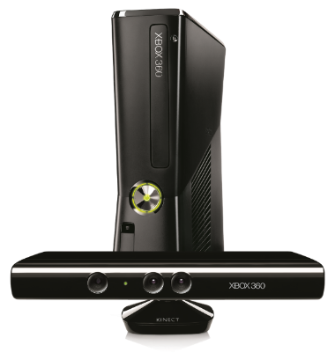




Complete an evaluation on CommNet and enter to win!

Slide 35
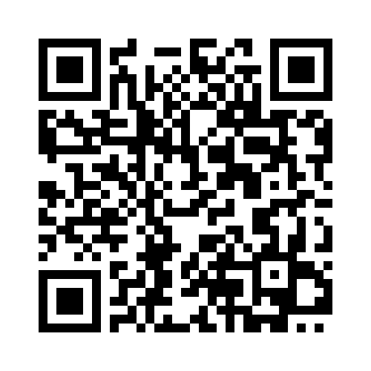

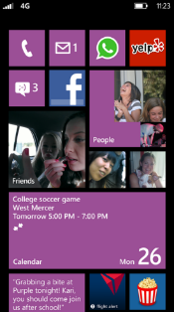
MS tag
Required Slide
*delete this box when your slide is finalized
Your MS Tag will be inserted here during the final scrub.
Scan the Tag to evaluate this session now on myTechEd Mobile

Slide 36

© 2013 Microsoft Corporation. All rights reserved. Microsoft, Windows and other product names are or may be registered trademarks and/or trademarks in the U.S. and/or other countries.
The information herein is for informational purposes only and represents the current view of Microsoft Corporation as of the date of this presentation. Because Microsoft must respond to changing market conditions, it should not be interpreted to be a commitment on the part of Microsoft, and Microsoft cannot guarantee the accuracy of any information provided after the date of this presentation. MICROSOFT MAKES NO WARRANTIES, EXPRESS, IMPLIED OR STATUTORY, AS TO THE INFORMATION IN THIS PRESENTATION.

